Slide 1
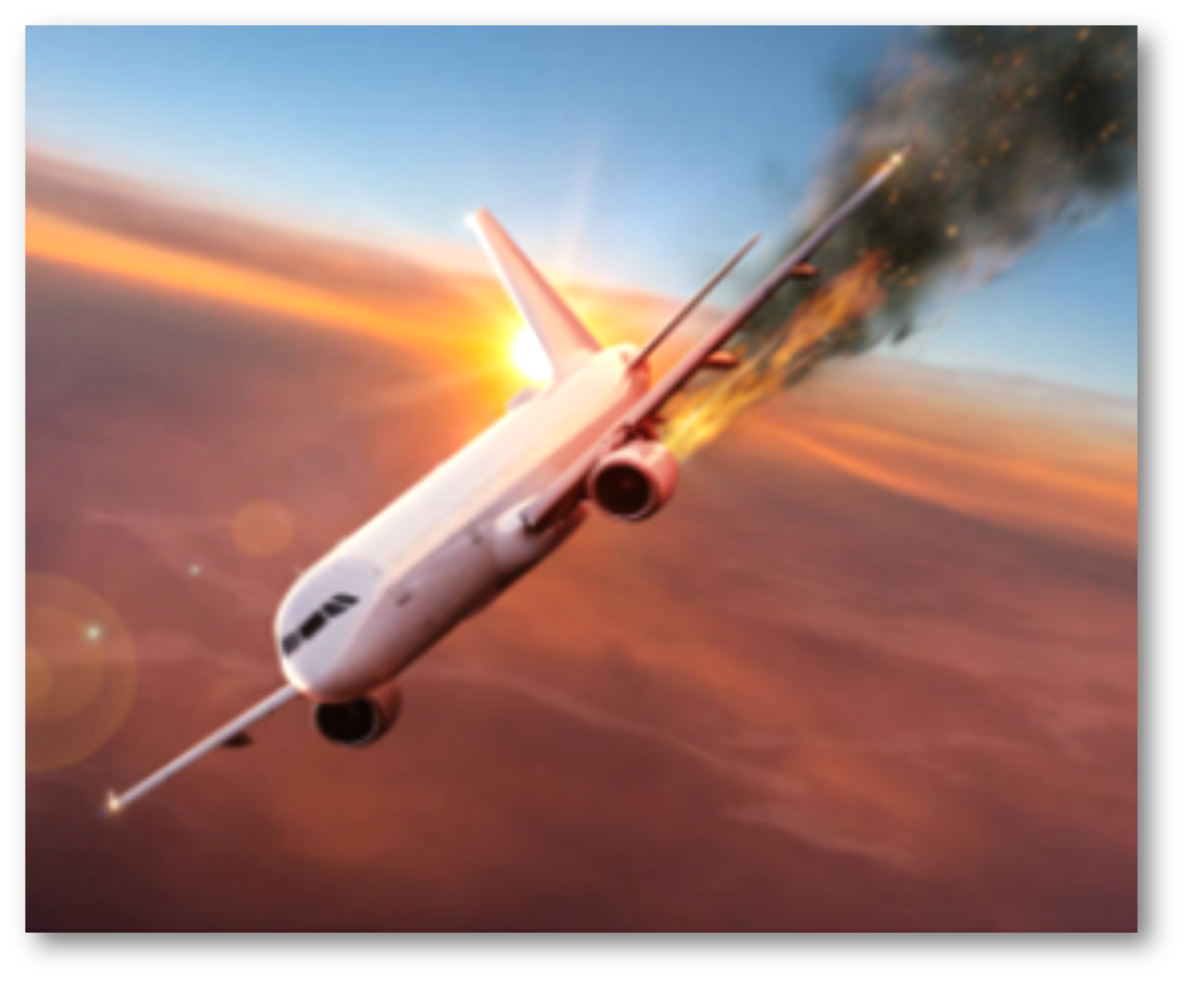
Airplane crashes analysis
CHINNU THOMAS

Slide 2
WHY WE DO THIS ANALYSIS
Airplanes the most efficient form of modern transportation ,make the world a small place by quickly delivering people and cargo from one place to another . As more and more people use airplanes as a means of transportation the no. of passengers and flight routes have expanded recent years . Taking these impacts into consideration this projects aims to discover and analyze reasons for airplane crashes , raise awareness of flight safety, and better understanding its problems and progress .

Slide 3
DATA SET
Collected data of airplane crashes from 1908 till 2009
13 unique variables
5268 crashes

Slide 4
DATA DICTIONARY
Date Date of the accident
Time Time of the accident
Location Location where the accident took place
Flight # Flight number
Operator Operator of the aircraft
Route Route
Type Type of aircraft
Registration Registration code
Cn/ln Construction/Serial/Line/Fuselage number
Aboard Number of people aboard
Fatalities Number of fatalities
Ground Number of people killed on the ground

Slide 5
DATA
visualization

Slide 6
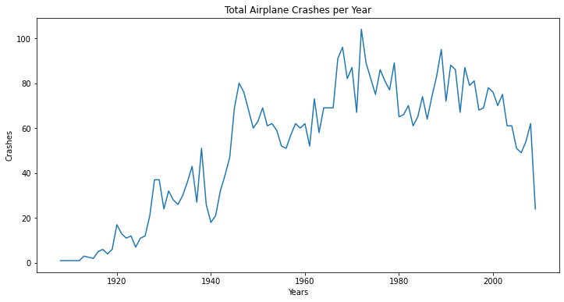
From the 40's, there's a significant increase in airplane crashes, which must Likely be because of World War II (1939 - 1945). The highest peaks are between 1960 and 2000. The year with most accidents is 1972, with 104 occurences.

Slide 7
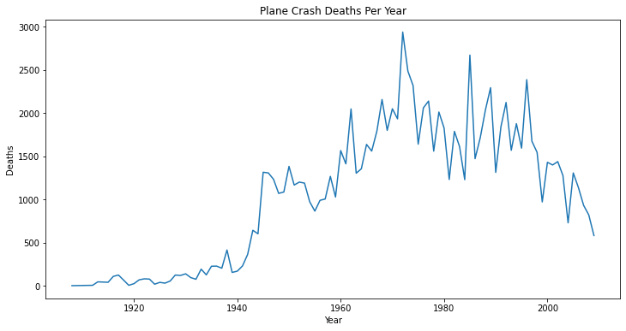
Here we can see the same pattern, the years that had the most accidents are also the ones with the most fatalities

Slide 8
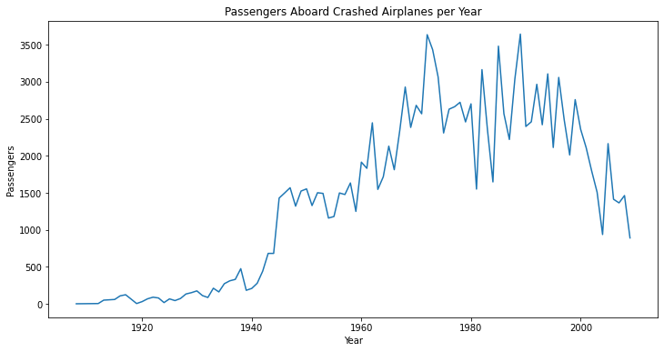
From the 40's, the number of people aboard airplanes starts to increase. From 1960 to 2000 is where we have most people aboard, the same years with most plane crashes and fatalities.

Slide 9
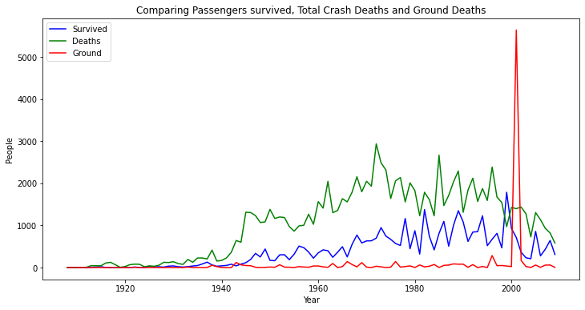
There's a peak close to 2000, with more than 5000 killed on the ground, way more than the number of fatalities. This dreadful number of people killed on the ground is due to the tragic event of 9/11, where the Twin Towers were brought down by two planes hijacked by terrorists.

Slide 10
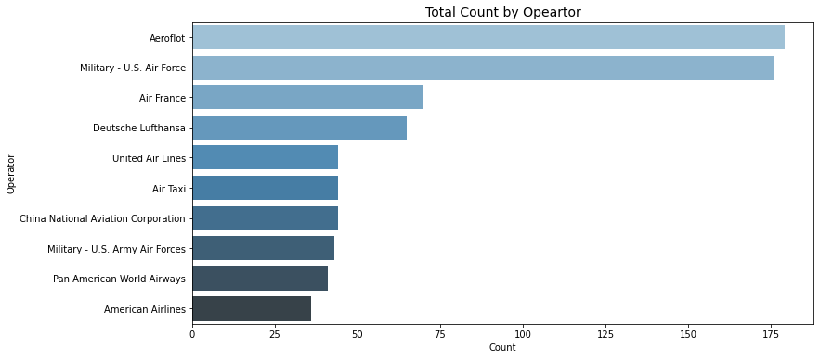
Aeroflot is the most dangerous operator. People have high chances of dying if they flew with Aeroflot than any other operator.

Slide 11
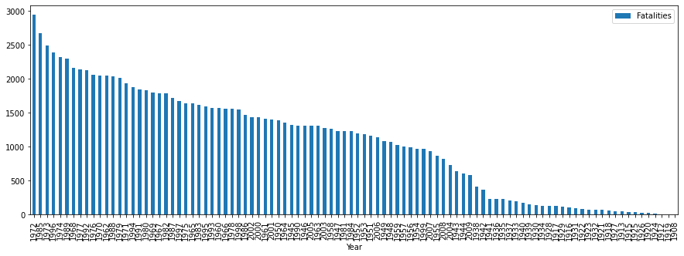
70s and 80s are among the worst years for airline industry. 1972 is the worst so far, causing maximum no. of fatalities

Slide 12
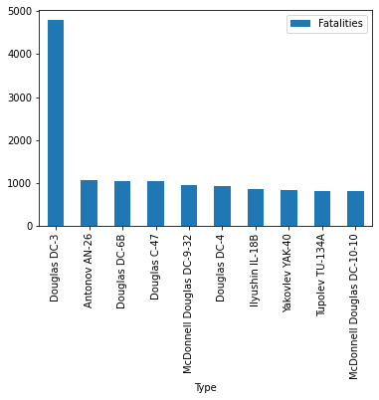
Douglas DC-3 is atleast 5 times more probable to crash than any other type of aircraft

Slide 13
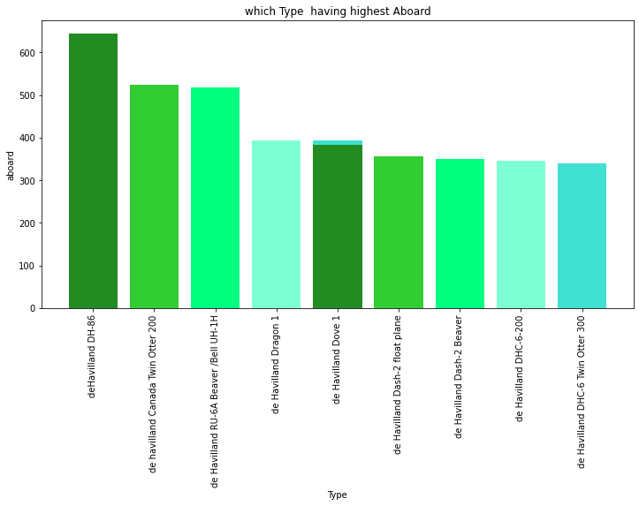
dehavilland DH has most no.of aboard , from the graph its clear that dehavilland type is most used and its variety types. This type and its variety is most demanding and this type can occupy more aboards than any other.

Slide 14
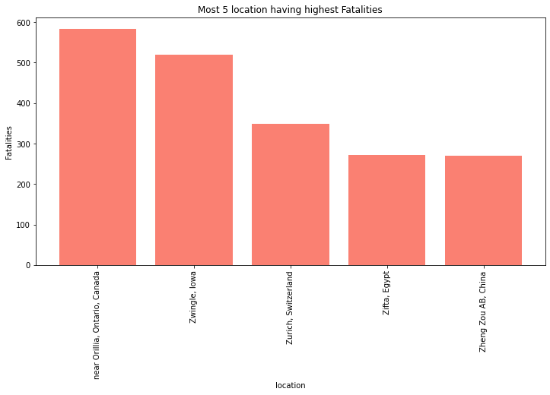
Canada have the highest no.of crashes occured and has highest fatalities.And this is most the riskiest location to fly.

Slide 15
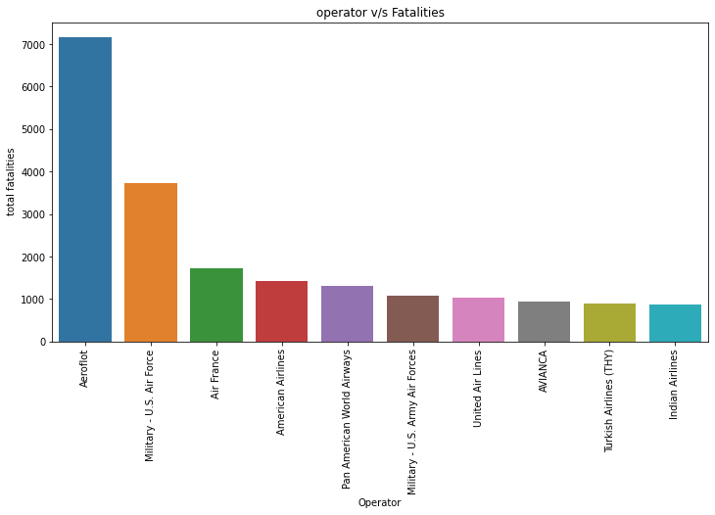
The operator aerflot is the most dangerous operator and have high fatalities than others.second most is Militry U.S air force.

Slide 16
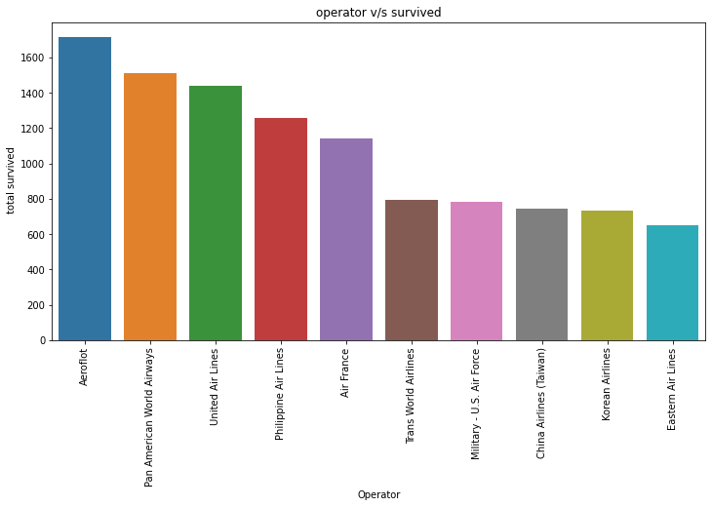
As we know that aerflot is the worst operator from our previous observations,eventhough there is a chance to suvival .in this graph the aerflot has the highest no.of survivers almost 1700 were survived .second most is pan american airways its around 1500 and so on.

Slide 17
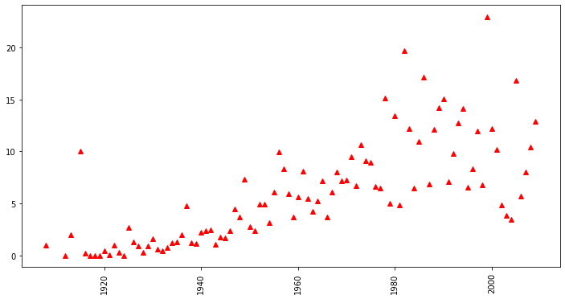
Earlier the survivor rate is really low and after 1980 there is a change in the pattern .which means after 1980's survivor rate is highly increasing,its a good sighn for aviation industry .And people using airlways also feel safer . technological development is also a factor.

Slide 18
CONCLUSIONS
This analysis will helpful for both aviation industry as well as people who choose air ways as their means of transportation .They get better understanding of how crashes happen ,is there any hope for survival in case anything happen, and how much safe it is?. We analyze data of around 101 yrs of plane crashes .From this its clear that early 40's,and 70's to 80's are the worst period of aviation industry . Lots of crashes and the fatalities rate also high, and also that time the world war 2 happed its also a reason for highest crash rates . Aeroflot was the worst operator and the planes have Douglas C3 as their type had the high chances to crash. The year which higher crashes were occur in 1972 around 104 crashes . Most accidents took place in Canada ,may be which is the riskiest location . The survived rates were increase from 1980's till 2009.which means technologies are improved the fatalities rates were decreased and also crash rates also decreased its a good sign . There is so many reasons for air accidents may be its technical issue ,air turbulence, terrorist attacks ,or may be pilots error . Even though which is a efficient form of modern transportation.

Slide 19
THANK YOU

